Slide 1



Warmia and Mazury Special
Economic Zone
INVEST AND BREATHE
A SIGH OF RELIEF
Join the Polish Investment Zone
and get tax relief

Slide 2





Who we are?
one of the 14 special economic zones (SEZ) in Poland
state-owned company which, on behalf of the Minister of Economy, issues decisions to support new investments under the Polish Investment Zone
under the government's investment support program – Polish Investment Zone, we manage an area located in two provinces - warminsko-wazurskie (19 poviats) and mazowieckie (11 poviats)
www.wmsse.com.pl

Slide 3
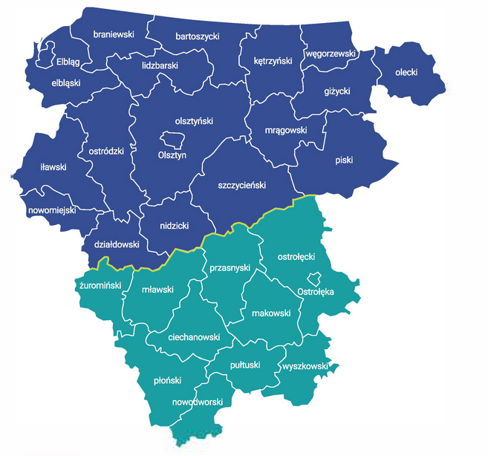
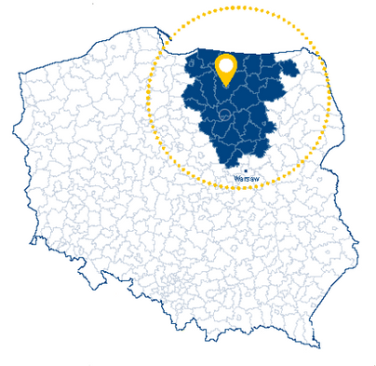

Where we operate?
WE MANAGE THE AREA OF:
 | warminsko-mazurskie | mazowieckie
Area | 22 288 km2 92,20% province's area | 11 237 km2 31,60% province's area
Population | 1,305 mln 91,83 % province’s population | 0,731 mln 31,60 % province’s population

Slide 4

Polish Investment Zone
Poland Investment Zone (PIZ) is an instrument introduced in 2018 to support new investment projects carried out with the territory of the Republic of Poland.
PIZ enables to obtain an exemption from the income tax related with the implementation of a new investment.
You can apply for tax relief all over Poland, regardless of the size of your company or the country of origin.
www.wmsse.com.pl

Slide 5

What is the support based on?
Recover of investment costs in unpaid income tax at the maximum value of up to 70% of investment costs
Public aid in the form of income tax relief
Tax exemption
for 10 to 15 years depending on location
www.wmsse.com.pl

Slide 6
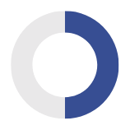
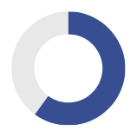
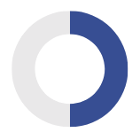
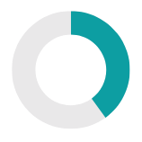
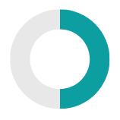

Level of support
warminsko-mazurskie province
50%
60%
70%
eligible expenses for
large companies
eligible expenses for
medium-sized companies
eligible expenses for
small and micro companies
mazowieckie
province
40%
50%
60%
eligible expenses for
large companies
eligible expenses for
medium-sized companies
eligible expenses for
small and micro companies

Slide 7







What kind of investments can be supported?
Tax relief for new investment can be obtained for
setting up of a new facility
introducing of new products
increasing the capacity
of an existing facility
major modification of the production process of an existing facility
acquiring assets of a facility that has closed (or would have closed had it not been purchased)

Slide 8

What can be eligible investment costs?
BASED ON INVESTMENT COSTS
COST BASED ON JOB CREATION
costs related to the purchase of land
cost of purchase or self-production of fix assets
cost of expansion or upgrade of existing fix assets
costs related to the purchase of patents rights, liceneses, know-how, etc.
cost of the lease of land and buildings
financial leasing of assets other than land and buildings
two–year employment costs associated with newly created jobs
www.wmsse.com.pl

Slide 9

Why invest with us?
The highest public aid in Poland – up to 70% of the
new investment value
Any business, no matter its size, can receive support
We will support any investment that meets specified criteria
Simple and fast procedure for obtaining support decisions
The airport in Modlin (150 km from Olsztyn) and Szymany (40 km from Olsztyn)
Sea port in Elbląg (100 km from Olsztyn)
www.wmsse.com.pl

Slide 10




Our biggest investments
ORLEN POŁUDNIE joint stock company - construction of an oil press.
Investment value: 629 961 560,60 PLN.
Type of investment: construction of press buildings, storage buildings and the purchase and installation of technological lines, machines and production equipment.
OSI Food Solutions Poland - construction of a poultry meat production facility.
Investment value: 294 435 000 PLN.
Type of investment: a production and warehouse building will be built along with the necessary external and internal infrastructure and a dedicated machinery park.
Egger Biskupiec LTD - construction of a woodworking facility.
Investment value: 917 210 000 PLN.
Type of investment: construction from scratch of a large wood processing facility, which, in addition to chipboard and melamine boards for the furniture industry, will also produce floor panels and various types of furniture.
M.I. CROW LTD - expansion of the existing production facility.
Investment value: 176 400 000 PLN.
Type of investment: purchase of production facility including technological lines, machines and production equipment as well as modernization of the machinery park, introduction of new technologies, development of new production (drones) and further products according to market demand.

Slide 11
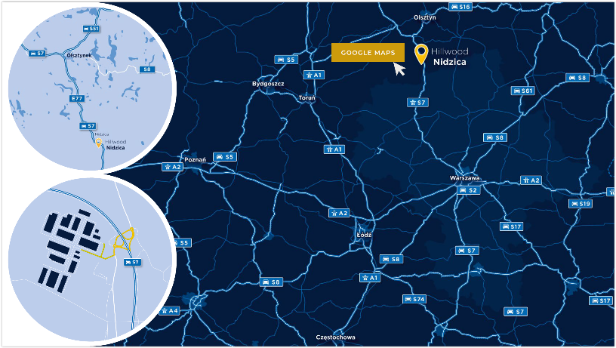
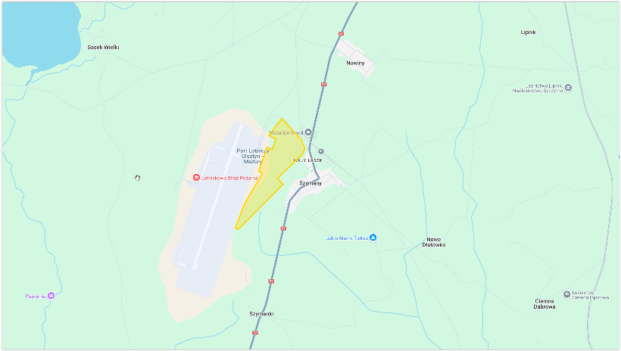
Investment areas
Industrial Park Nidzica:
Location: Kanigowo district, Nidzica municipality, directly adjacent of S7 expressway;
Size: 114 hectares;
Infrastucture: electricity, water, gas, sewage system.
Investment area in Szymany:
Location: Szymany district, Szczytno municipality, immediate vicinity of the airport and the railway line;
Size: 59,7389 hectares;
Infrastucture: electricity, water, sewage system, road lighting.
Expressway S7: 100 m
Expressway S51: 35 km
Seaport in Elbląg: 130 km
Nearest airport: Olsztyn-Mazury – 54 km
Voivodship capital (Olsztyn): 62 km
National road (no. 57): 1 km
Expressway S7: 81 km
Seaport in Elbląg: 170 km
Nearest airport: Olsztyn-Mazury – 100 m
Voivodship capital (Olsztyn): 59 km

Slide 12





The results of our activities
450
supported investments
over 10 bn PLN
in capital expenditure
170
firms currently supported
26 000
new workplaces

Slide 13
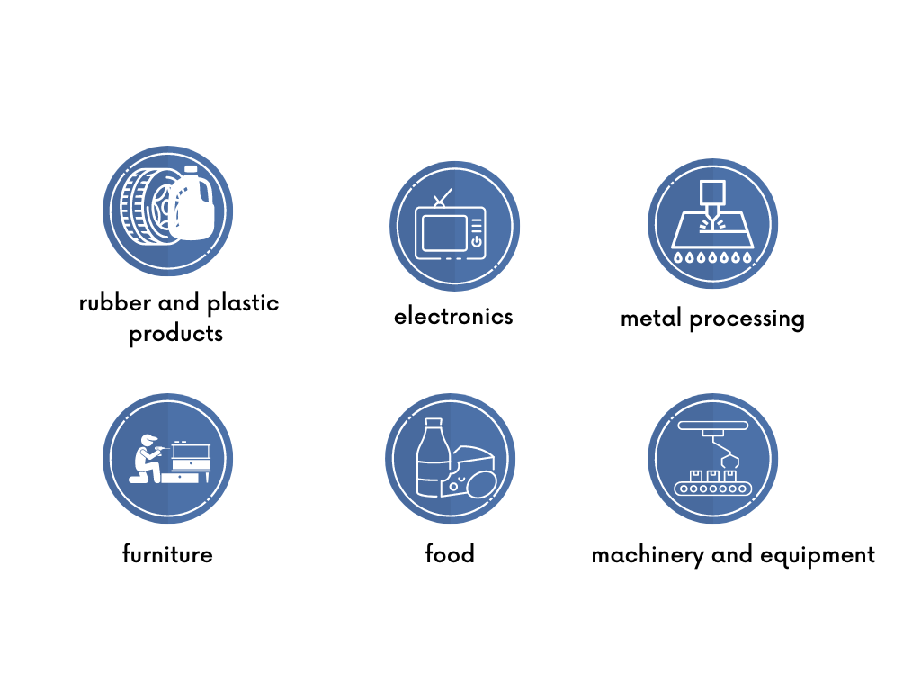
Leading industries

Slide 14









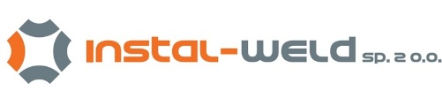



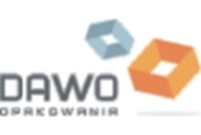























Our investors
small and micro companies
medium-sized companies
large companies
www.wmsse.com.pl

Slide 15




Giggling Platypus Co.
INVEST WITH US
AND
BREATHE A SIGH OF RELIEF
Contact us
Warmia and Mazury Special Economic Zone
ul. Barczewskiego 1, 10-061 Olsztyn
phone: +48 89 535 02 41
e-mail: wmsse@wmsse.eu
www.wmsse.com.pl
+123-456-7890
www.reallygreatsite.com
123 Anywhere St., Any City, ST 12345
Page 13
By Pedro Fernandes

